Slide 1
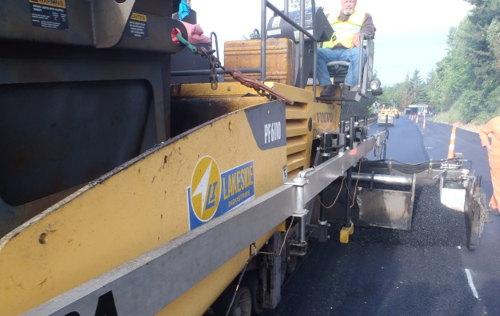
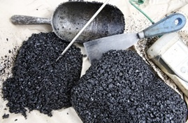
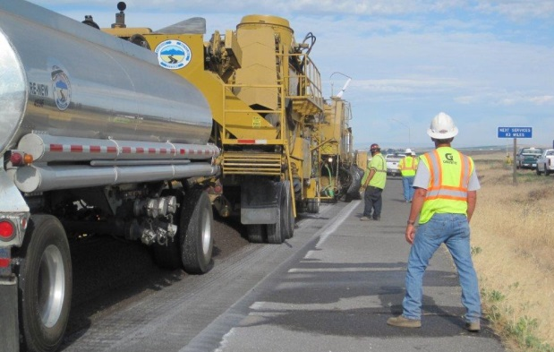
Paving Potpourri
2015 Spec Changes and More!
Bob Dyer
Assistant State Construction Engineer
Lynn Peterson
Secretary of Transportation
WAPA Joint Training
March 2015

Slide 2
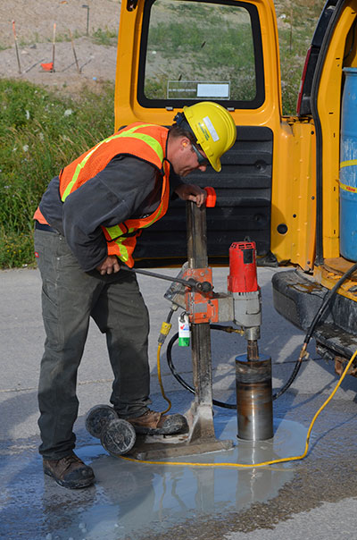
Spec Changes – Done Deal
Eliminate Anti-Strip in temp HMA
RAP/RAS
Current RAP/RAS will be an amendment in April 2015
Density Acceptance by Cores
Bid item for projects we want Contractor to core

Slide 3
Spec Changes – Done Deal
Pavement Smoothness
January 2015 GSP
Mix Design Approval with QPL
April 2015

Slide 4
Spec Changes – Done Deal
Test Frequency
As of January 2015
Mix Sublot size
From 1/800T to 1/1000T
Density Sublot size From 1/80T to 1/100T
As of April 2015
HMA Mix
HMA Project Quantity (tons) | Sublot Size (tons)
<20,000 | 1,000
20,000 to 30,000 | 1,500
>30,000 | 2,000
HMA Density
HMA Project Quantity (tons) | Sublot Size (tons)
<20,000 | 100
20,000 to 30,000 | 150
>30,000 | 200

Slide 5
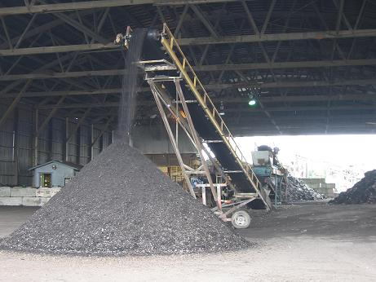
Spec Changes – Coming but not Finalized
Increase in RAP Percent
Nationally 0-15% OK; 15-25 drop a binder grade; >25 detailed mix design (like what we do now)
HMA On bridge decks
Should be something (GSP or amendment) by August 2015

Slide 6
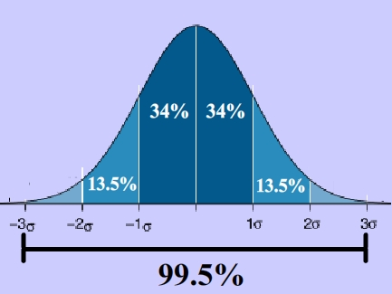
HMA Points of Emphasis
Old Way
Pass/Fail with tolerance on an individual test
Today’s Way:
Statistical Evaluation

Slide 7
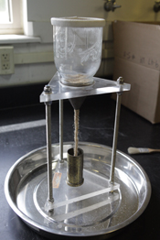
HMA Points of Emphasis
Standard Spec 3-04
Fine Aggregate Angularity
Sand Equivalent
Coarse Aggregate Fracture

Slide 9
Hot Mix Asphalt Unit Bid Price

Slide 10
Government Regulation and Taxes

Slide 11
Government Regulation and Taxes

Slide 12
Bob Dyer
Assistant State Construction Engineer, Roadway
DyerB@wsdot.wa.gov
360.705.6980

