Slide 1
2014
Washington Asphalt Conference
“Specification Update & Initiatives”
Joe DeVol
Assistant State Materials Engineer
State Materials Laboratory

Slide 2
Specification Updates
2014 Updates
4-06 & 9-03.6 - Asphalt Treated Base
Deleted - unused and incompatible with Superpave specifications
9-03.8(4) - Blending Sand
Deleted - considered part of mineral aggregate

Slide 3
Specification Updates
2014 Updates
9-03.8(1) - General Requirements
Added Sand Equivalent requirement to aggregate source approval
Restricted amount of No. 4 minus material - 5 percent by total weight of aggregate

Slide 4
Specification Updates
2014 Updates
5-04.3(3)A - Material Transfer Device/Vehicle
Amended - Engineer authority to exclude where not feasible

Slide 5
Specification Updates
2014 Updates
5-04.3(7)A1 - General Contractor Mix Design Requirements
AASHTO T 324 - Hamburg Wheel-Track Testing
ASTM D 6931 - Indirect Tensile Strength (IDT)
Brand and type of anti-stripping additive, certificate of compatibility
Optional See GSP

Slide 6
Specification Updates
2014 Updates
5-04.3(7)A2 - Statistical or Nonstatistical Evaluation Contracting Agency Evaluation
AASHTO T 324 - Hamburg Wheel-Track Testing
ASTM D 6931 - Indirect Tensile Strength (IDT)

Slide 7
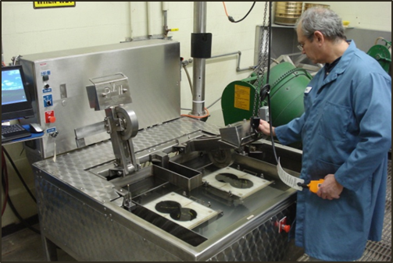
Specification Updates
2014 Updates
9-03.8(2) - HMA Test Requirements
Hamburg & IDT

Slide 8
Specification Updates
Mix Criteria | HMA Class
 | ⅜ inch |  | ½ inch |  | ¾ inch |  | 1 inch
 | Min. | Max. | Min. | Max. | Min. | Max. | Min. | Max.
Hamburg Wheel-Track Testing, WSDOT FOP for AASHTO T 324 Rut Depth (mm) @ 15,000 Passes |  | 10 |  | 10 |  | 10 |  | 10
Hamburg Wheel-Track Testing, WSDOT FOP for AASHTO T 324 Minimum Number of Passes With no Stripping Inflection Point | 15,000 |  | 15,000 |  | 15,000 |  | 15,000
Indirect Tensile (IDT) Strength (psi) of Bituminous Materials WSDOT FOP for ASTM D 6931 |  | 175 |  | 175 |  | 175 |  | 175

Slide 10
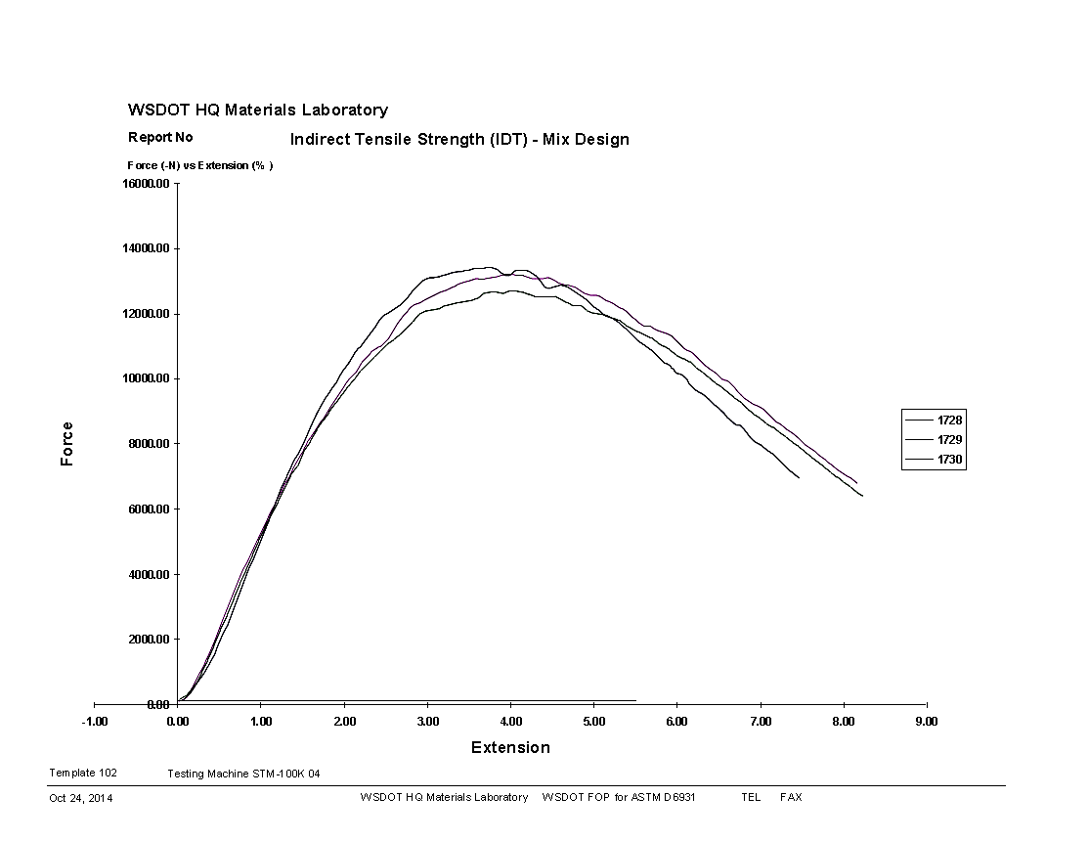

Slide 11
Specification Updates
2014 Updates
5-04.3(10)B1 - General
Added use of roadway cores to determine pavement density
For use when practical & cost effective
Includes bid item for Contractor coring

Slide 12
Specification Updates
2014 Updates
5-04.3(10)B3 -Longitudinal Joint Density
Deleted – now testing within 0.5’ of joint

Slide 13
Specification Updates
2014 Updates
5-04.3(20) - Anti-Stripping Additive
Added to the liquid asphalt prior to shipment
5-04.5 - Payment
Bid price for HMA includes anti-stripping additive

Slide 14
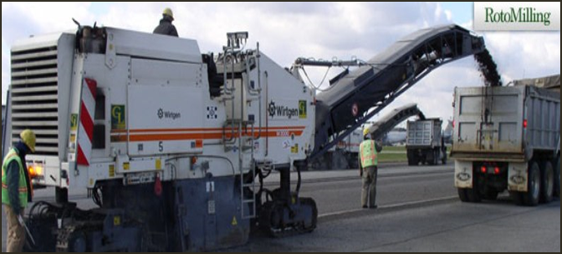
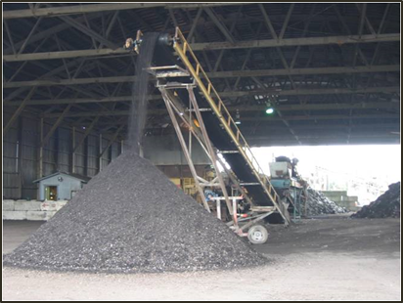
Specification Updates
2015 Updates
QPL Mix Design Approval Process
HMA Mixture & Density Test Sub-lot Sample Size Changes
High RAP & RAS - GSP to Standard Specification
5-04.3(13) Surface Smoothness – revisions pending

Slide 15
Washington Asphalt Conference
“Specification Updates & Initiatives”
2014
Questions?

